Slide 1
Digital technology monitored and controlled oral endotoxin activity levels for personalised primary and secondary prevention of gum diseases and related systemic complications
Dr Svetislav Zaric
NIHR academic clinical lecturer
Specialty registrar in periodontology
Faculty of dentistry, oral & craniofacial sciences
King’s college london, UK

Slide 2
Unmet need
So far, the diagnostic focus, in periodontics, has been on determining the extent of the historical tissue breakdown (PPD, CAL), rather than on detecting the biological start of the diseases.
As periodontal diseases are episodic and site-specific in nature, with still unknown factors that drive the progression from gingivitis to periodontitis, unique challenges lie for identification and monitoring of periodontal conditions.
The proposed approach falls within the scope of P4 healthcare (predictive, preventive, personalized, and participatory), with the ability to identify unique patient profiles, predict specific disease trajectories and to enable targeted disease management.

Slide 3
Unmet need
Our aim is to develop and validate a rapid and reliable test based on oral bacterial endotoxin profile, which can be used routinely by the dental care professionals and the wider public, in order to maintain and improve oral health and quality of life and to encourage access to dental care and reduce health disparities.
The test would be made in two versions:
Salivary test for home, patient-performed self-testing for early detection and prevention of periodontal diseases or their relapse, before significant tissue destruction occurs, and
2) Subgingival plaque test for the chair-side use by dental professionals for personalised, site-specific,
point-of-time periodontal conditions management.

Slide 4
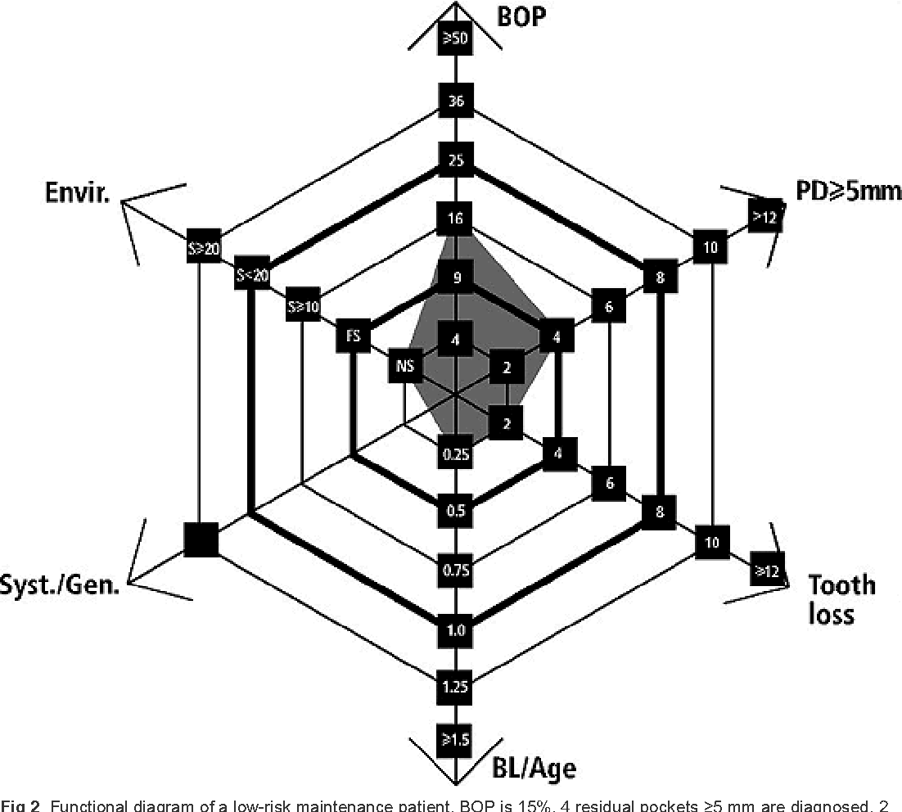
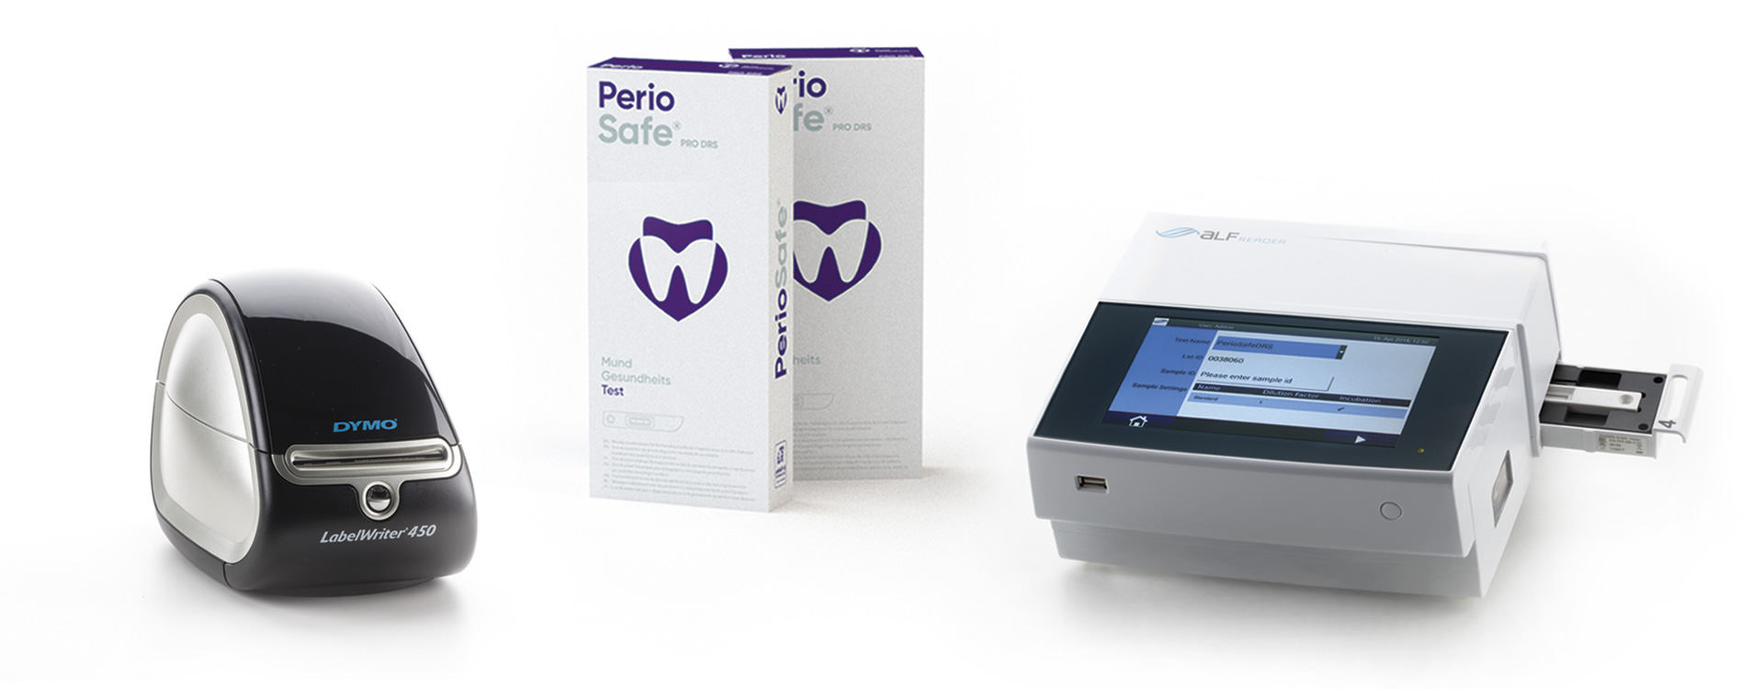
The Market
Current periodontal risk assessment is based on surrogate measures, such as BOP, tooth loss, number of sites of 5mm or greater, environmental, and systemic factors (Lang, Tonetti 2003).
The only commercially available, chair-side test for monitoring the progression of periodontal disease is based on measuring the active MMP-8 enzyme, which is indicative of collagen breakdown (PerioSafe, Dentognostics, Germany). However, with low sensitivity (67.1%) and specificity (68.8%).
Our endotoxin activity-based test can detect minor dysbiotic changes in the oral environment and is therefore one step ahead, in view of periodontitis pathogenesis, compared to the competitor. It also has better specificity and sensitivity (91% and 85%).

Slide 5
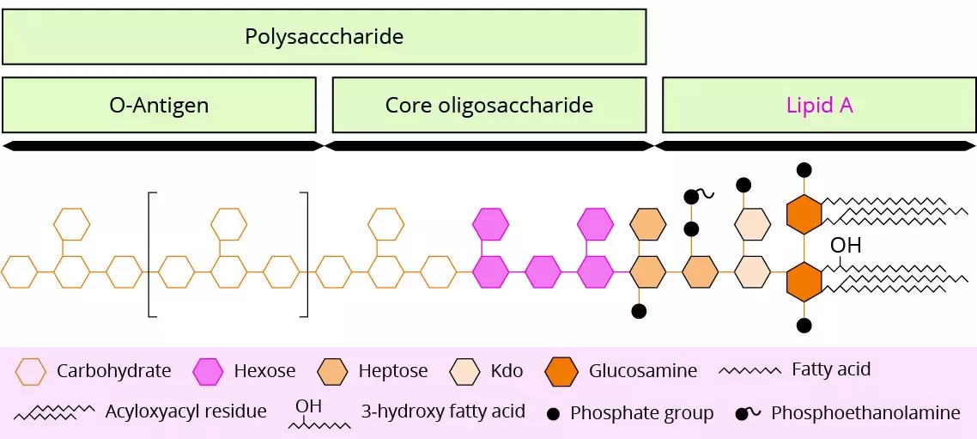
Presentation of the idea
The most important risk factor for periodontitis is the accumulation of a dysbiotic dental biofilm at and below the gingival margin, which is associated with an inappropriate and destructive host inflammatory immune response.
Lipopolysaccharide (LPS) is the major constituent of the outer membrane of Gram-negative bacteria and a key microbial stimulus that triggers the host response at periodontal tissues.
Host’s inflammatory can be activated by structurally diverse LPS molecules, and minor changes in the LPS chemical composition can affect their inflammatory potential.

Slide 6
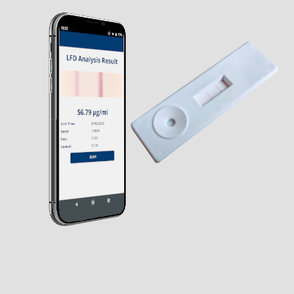
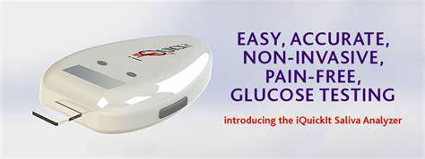
Hypothesis:
Subgingival and salivary endotoxin activity levels can be used as reliable, bacterially-derived biomarkers and a risk assessment tool for prevention of periodontal diseases and personalised periodontal care.
The aim of the project is:
To develop and evaluate a quick, efficient and objective screening, monitoring and diagnostic method, based on the subgingival and salivary LPS activity assay, with the ability to screen for susceptibility to periodontal diseases, identify disease progression, evaluate response to treatment and predict future tissue destruction.
Smart phone–based Lateral Flow salivary test for home testing
Site-specific, subgingival plaque testing for professional use.

Slide 7
Business plan
Commercialisation of this product (Technology readiness level 9) will be achieved through established bioMerieux channels.
The estimated cost of production of the salivary lateral flow-based test (for home testing) is 1.20 euros with the cost to the customer of 3 euros. The digital reader for the use in dental surgeries would cost around 35 euros and each testing strip 50 cents, with the cost to the customer included in the periodontal treatment, maintenance or check-ups.

Slide 8
Literature
- Svetislav Zaric, Alexander Strachan, Yuko Kurushima, Anbo Dong, Clare McIlwaine, Zoe Harrington, Luigi Nibali, Andrew Foey and Mark Ide. Evaluating clinical utility of subgingival and salivary endotoxin activity levels as periodontal biomarkers. Front. Oral. Health, 01 November 2022. Sec. Oral Infections and Microbes. DOI: 10.3389/froh.2022.1029806
- Zaric S, Ide M, Nibali L. New Insights Into the Pathogenesis of Periodontal Diseases. Dental Update 49(4): 314-317, April 2022. DOI: 10.12968/denu.2022.49.4.314
- Pirkko Pussinen, Elisa Kopra, Milla Pietiäinen, Markku Lehto, Svetislav Zaric, Susanna Paju, Aino Salminen. Periodontitis and cardiometabolic disorders: the role of lipopolysaccharide and endotoxemia. Periodontology 2000. June 2022 doi: 10.1111/prd.12433
- Mcilwaine C, Strachan A, Harrington Z, Jerreat M, Belfield LA, Sandor V, Foey A, Zaric S. Comparative analysis of total salivary lipopolysaccharide chemical and biological properties with periodontal status. Arch Oral Biol. 2020 Feb;110:104633.
- Strachan A, Harrington Z, McIlwaine C, Jerreat M, Kilar A, Belfield L, Jackson S, Foey A, Zaric S. Subgingival lipid A profile and endotoxin activity in periodontal health and disease. Clinical Oral Investigations, Sept 2019. https://doi.org/10.1007/s00784-018-2771-9

